Slide 1
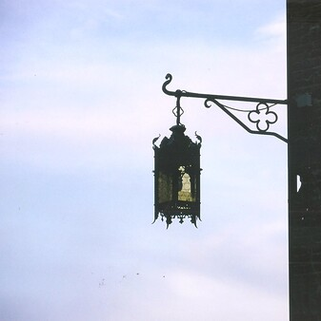
What do you do?
It is 79 AD
You’re in South Italy
It’s about lunch time
Everyone is going about their usual day
It is very hot and it is not windy
But you notice the lamps swinging and many dogs begin to bark
You look around

Slide 2
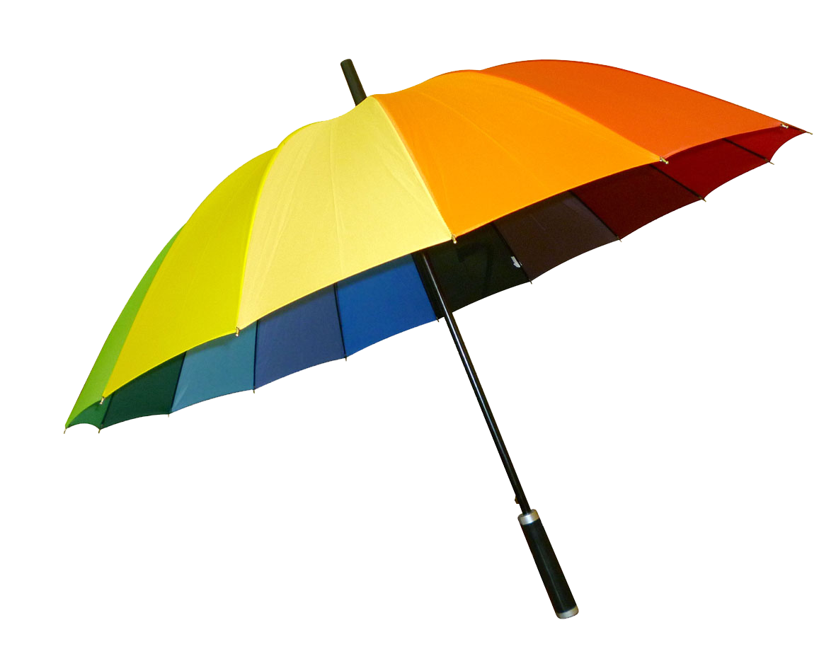
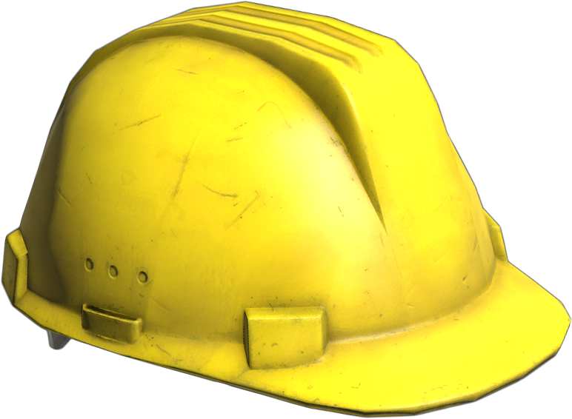
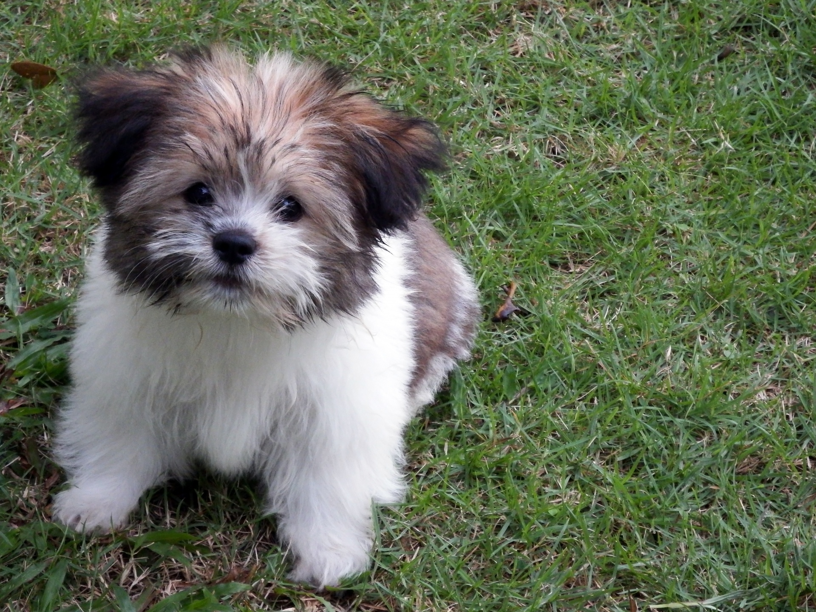
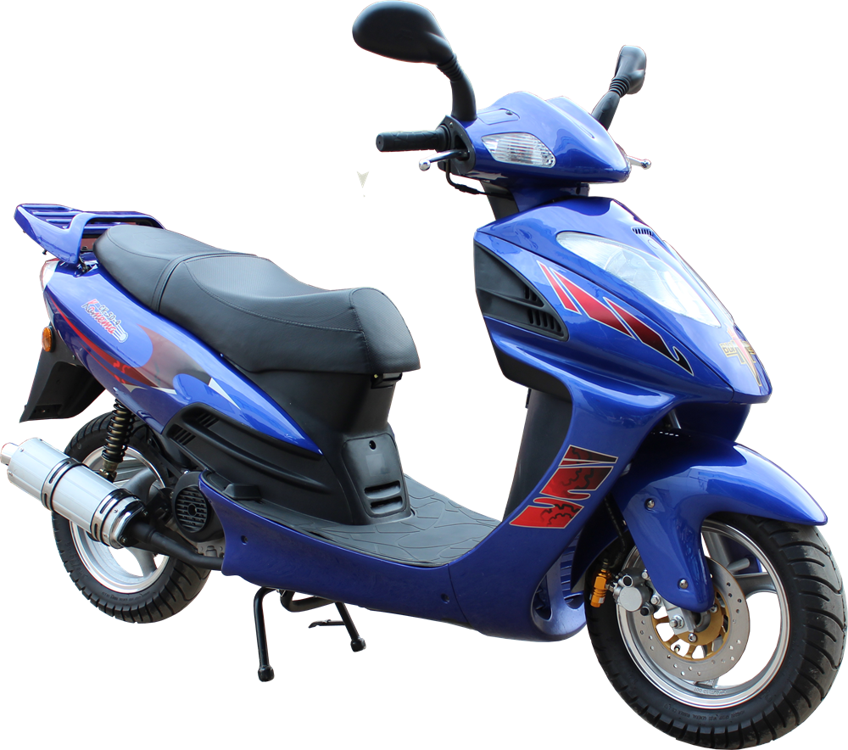
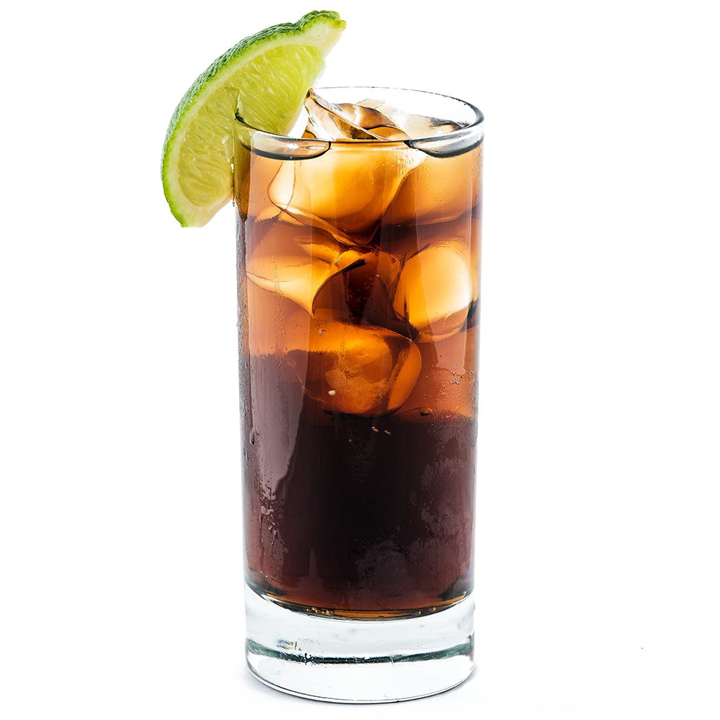
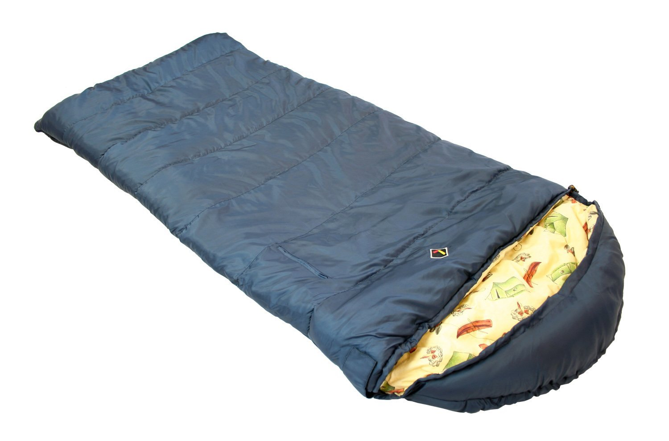

Slide 3
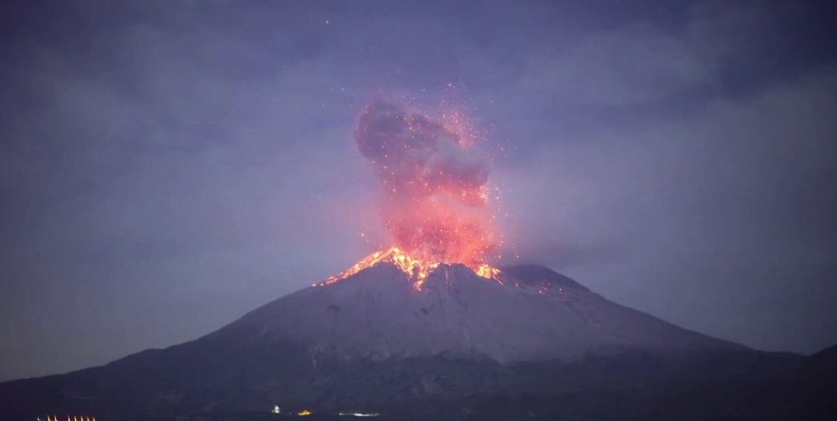

Slide 4
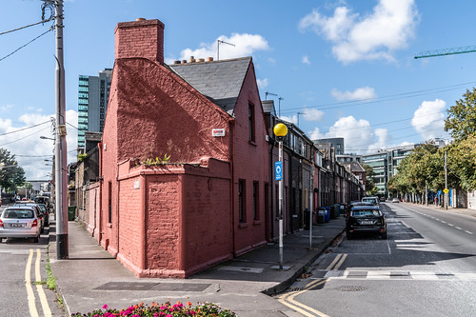
What do you do?
It is the year 2009 AD, summer.
You’re in the state of Victoria, Australia
You’re in your friend’s home
Everyone is going about their usual day
It is very hot and it is very windy
You smell something unusual
You look around

Slide 5
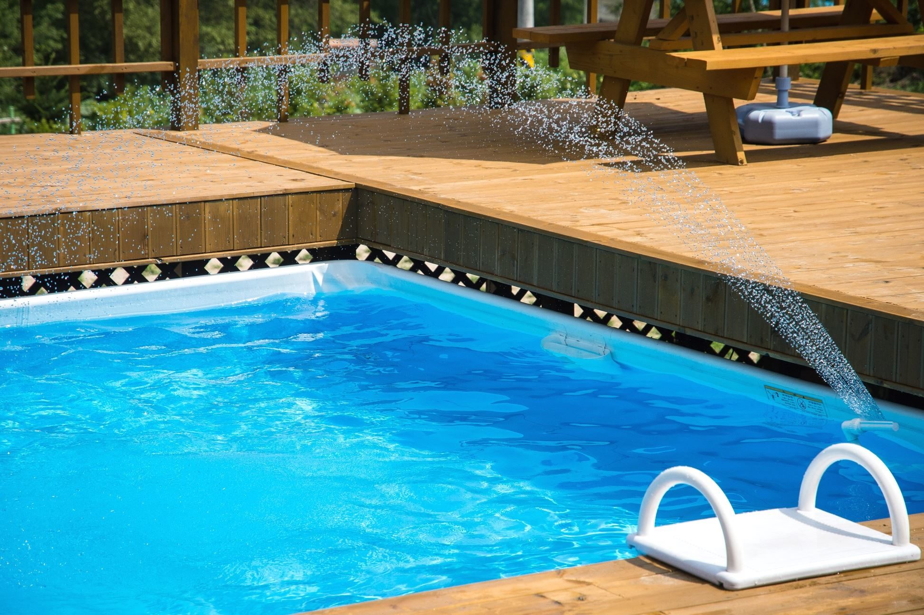


Slide 6
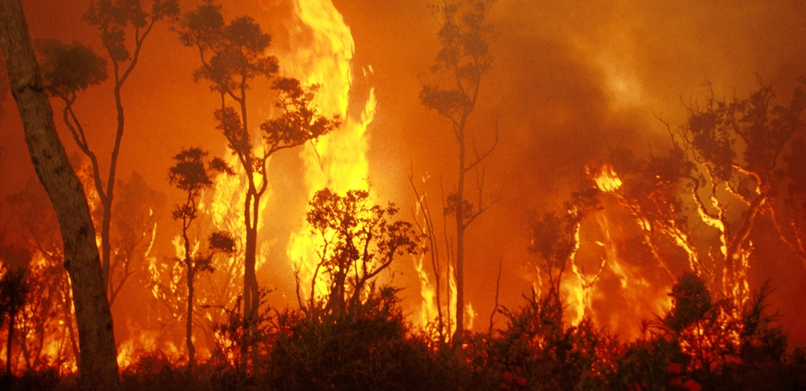

Slide 7
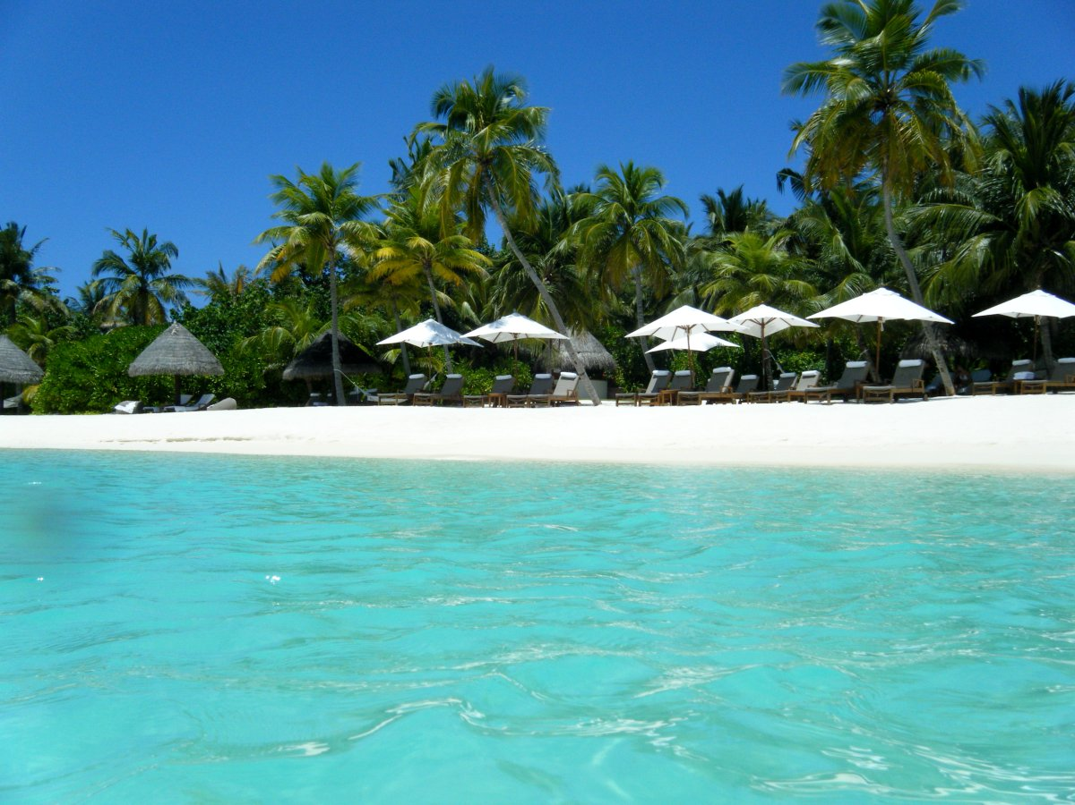
What do you do?
It is the year 2004 AD on 26 Dec
You’re enjoying a swim in the Maldives on holiday
Everyone is going about their usual day
You hear a lot of people suddenly shouting and pointing
You look around
This Photo by Unknown Author is licensed under CC BY

Slide 8
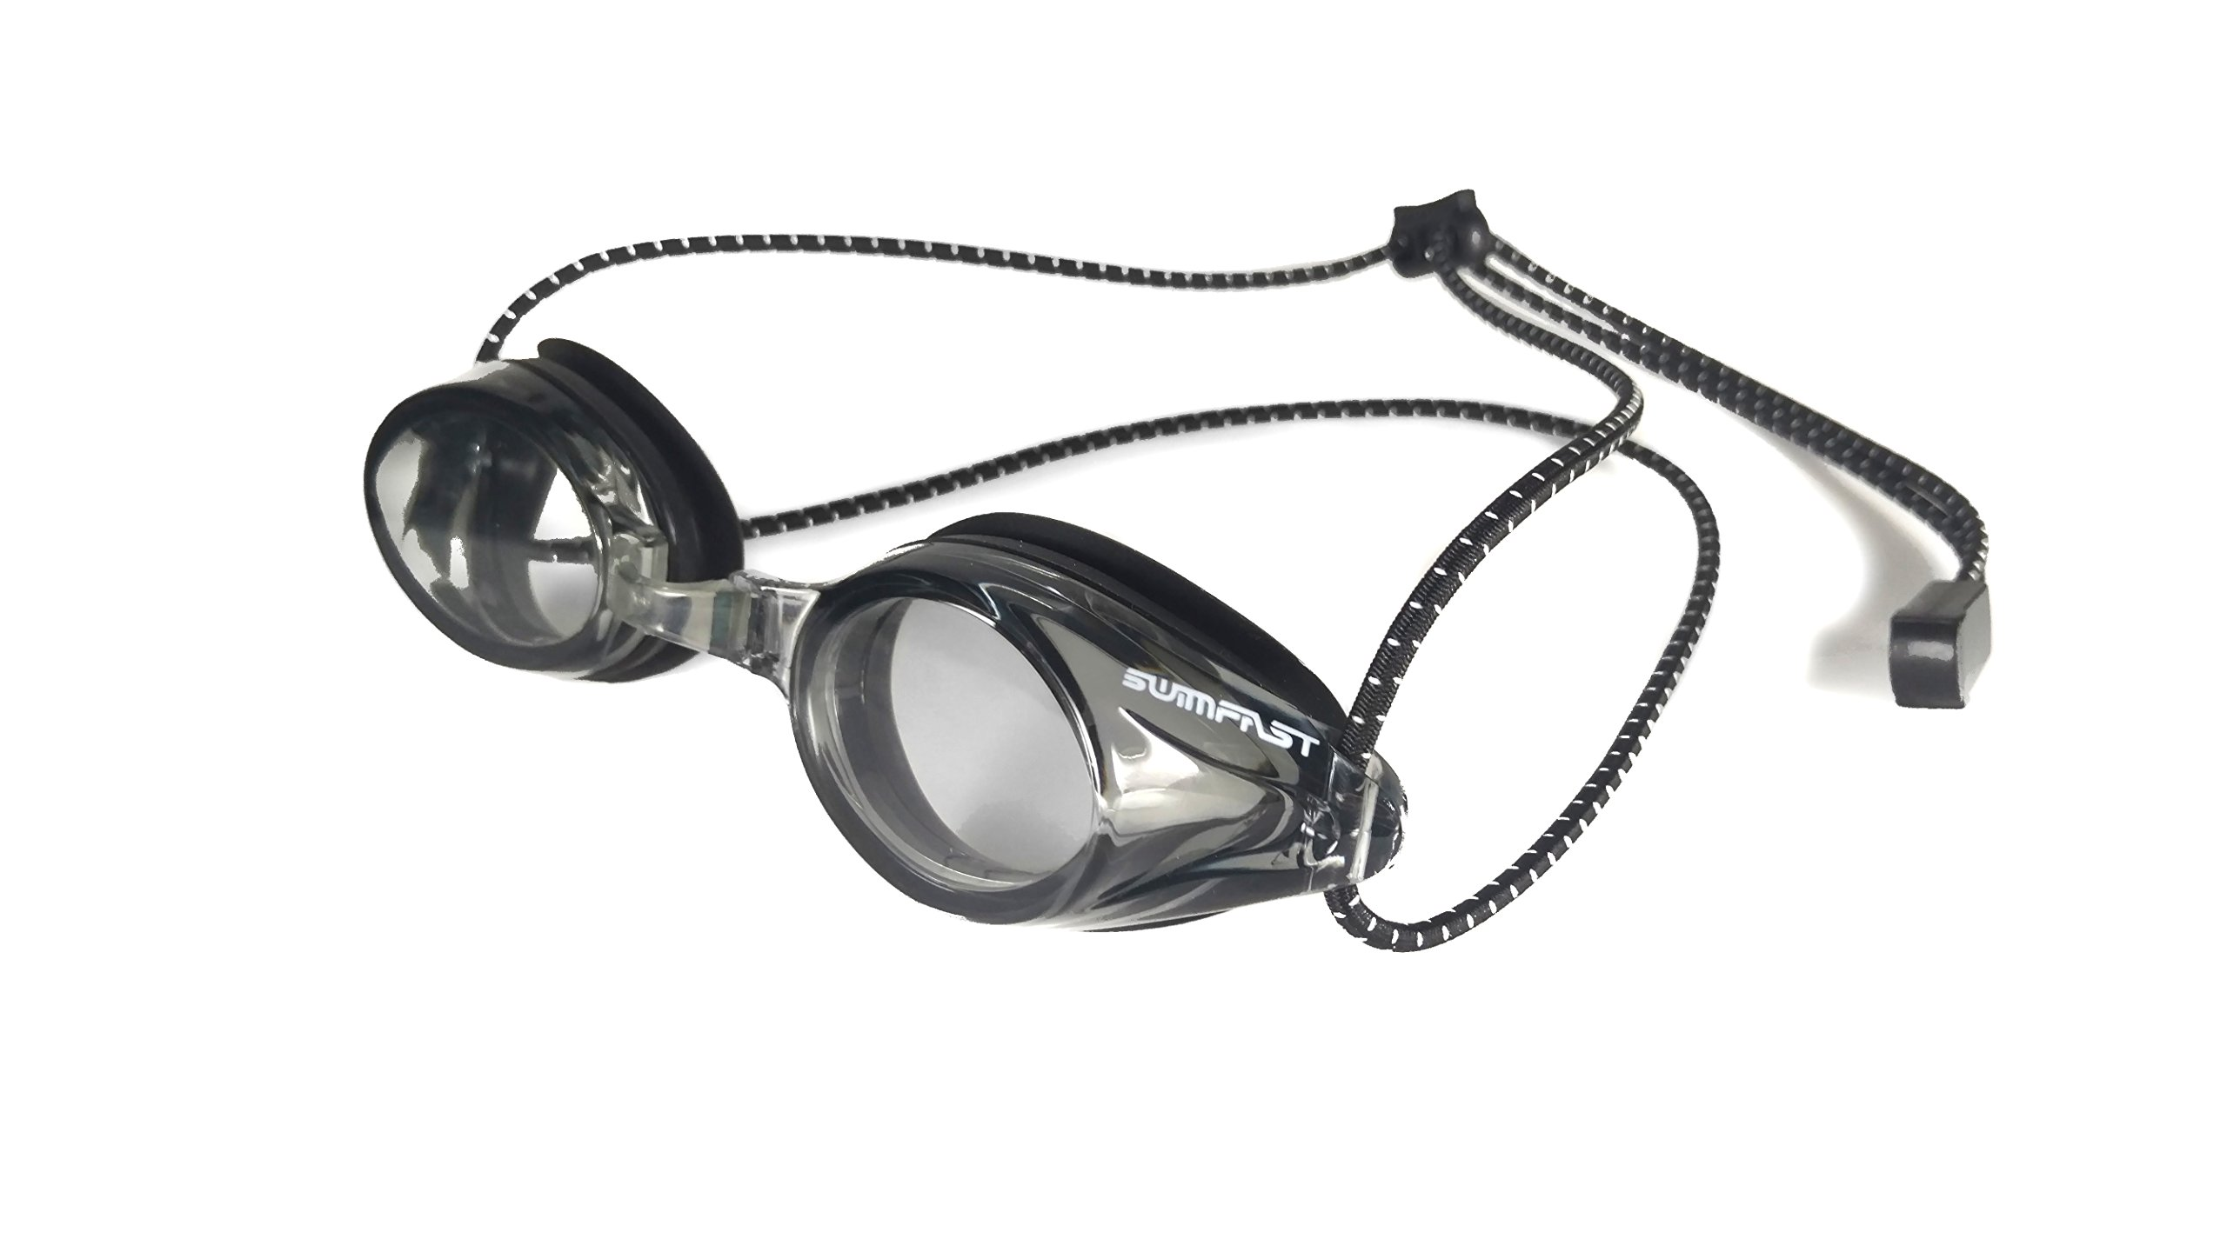
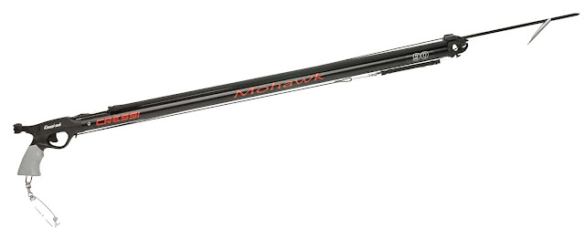
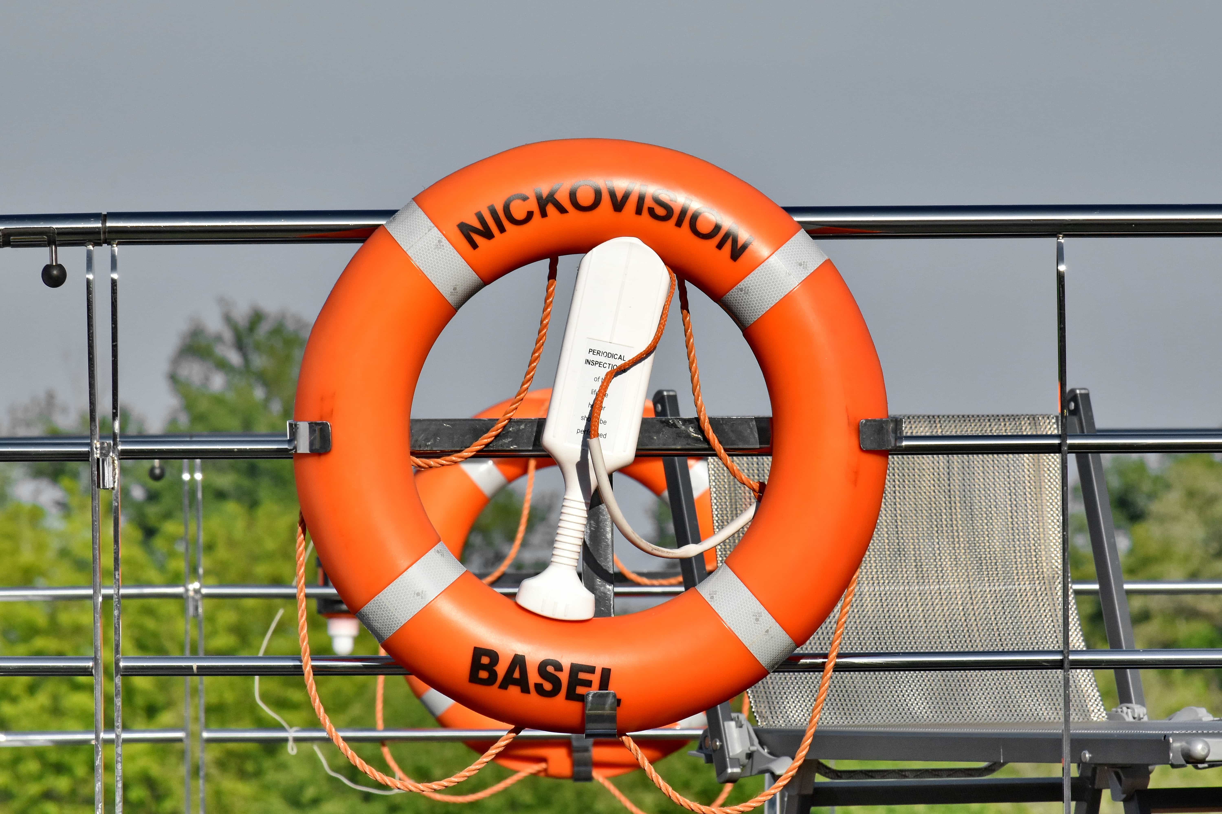

Slide 9
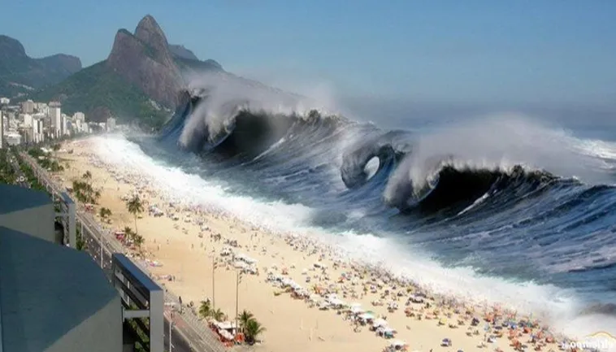

Slide 10
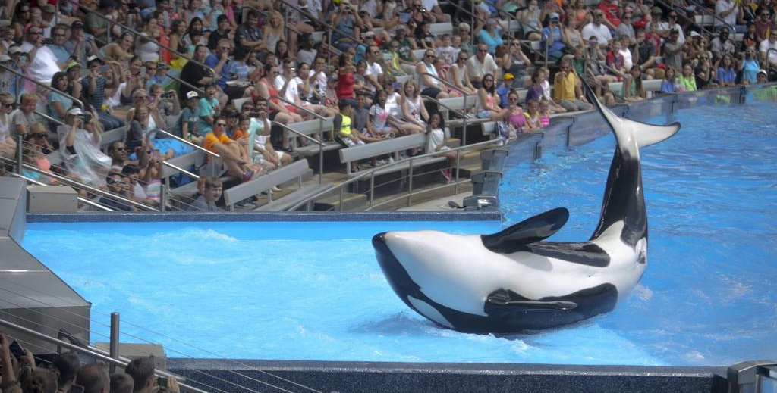
What do you do?
It is the year 2006 AD
You’re enjoying watching the show at Seaworld
Everyone is going about their usual day
You hear a lot of people suddenly shouting and pointing
You look around

Slide 11
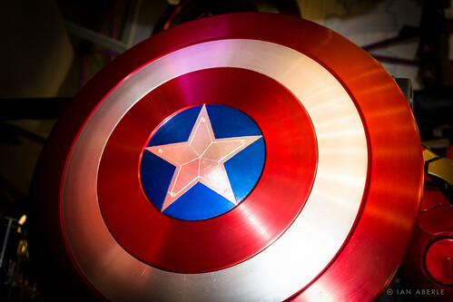
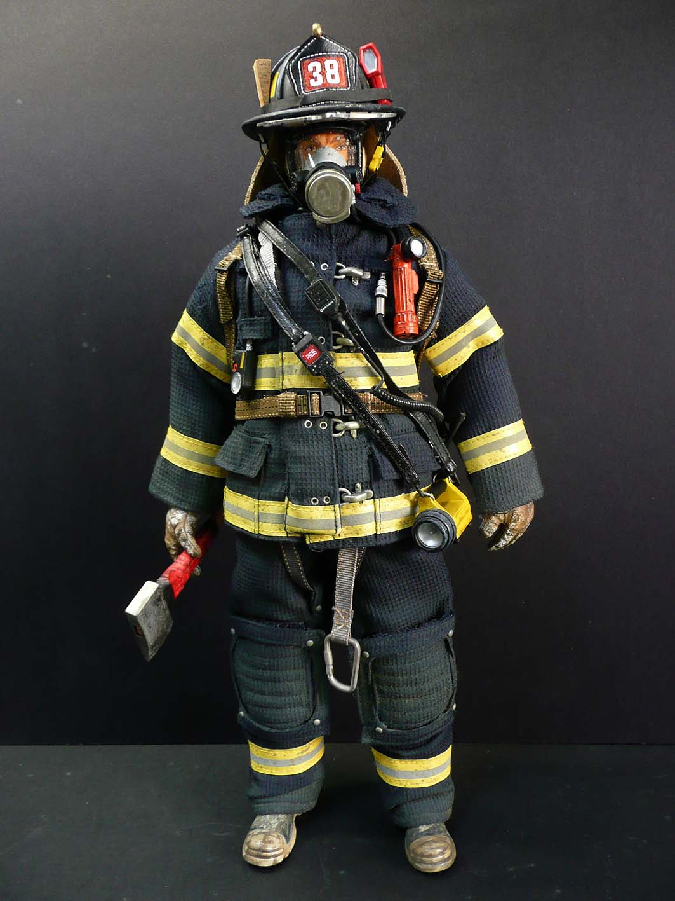
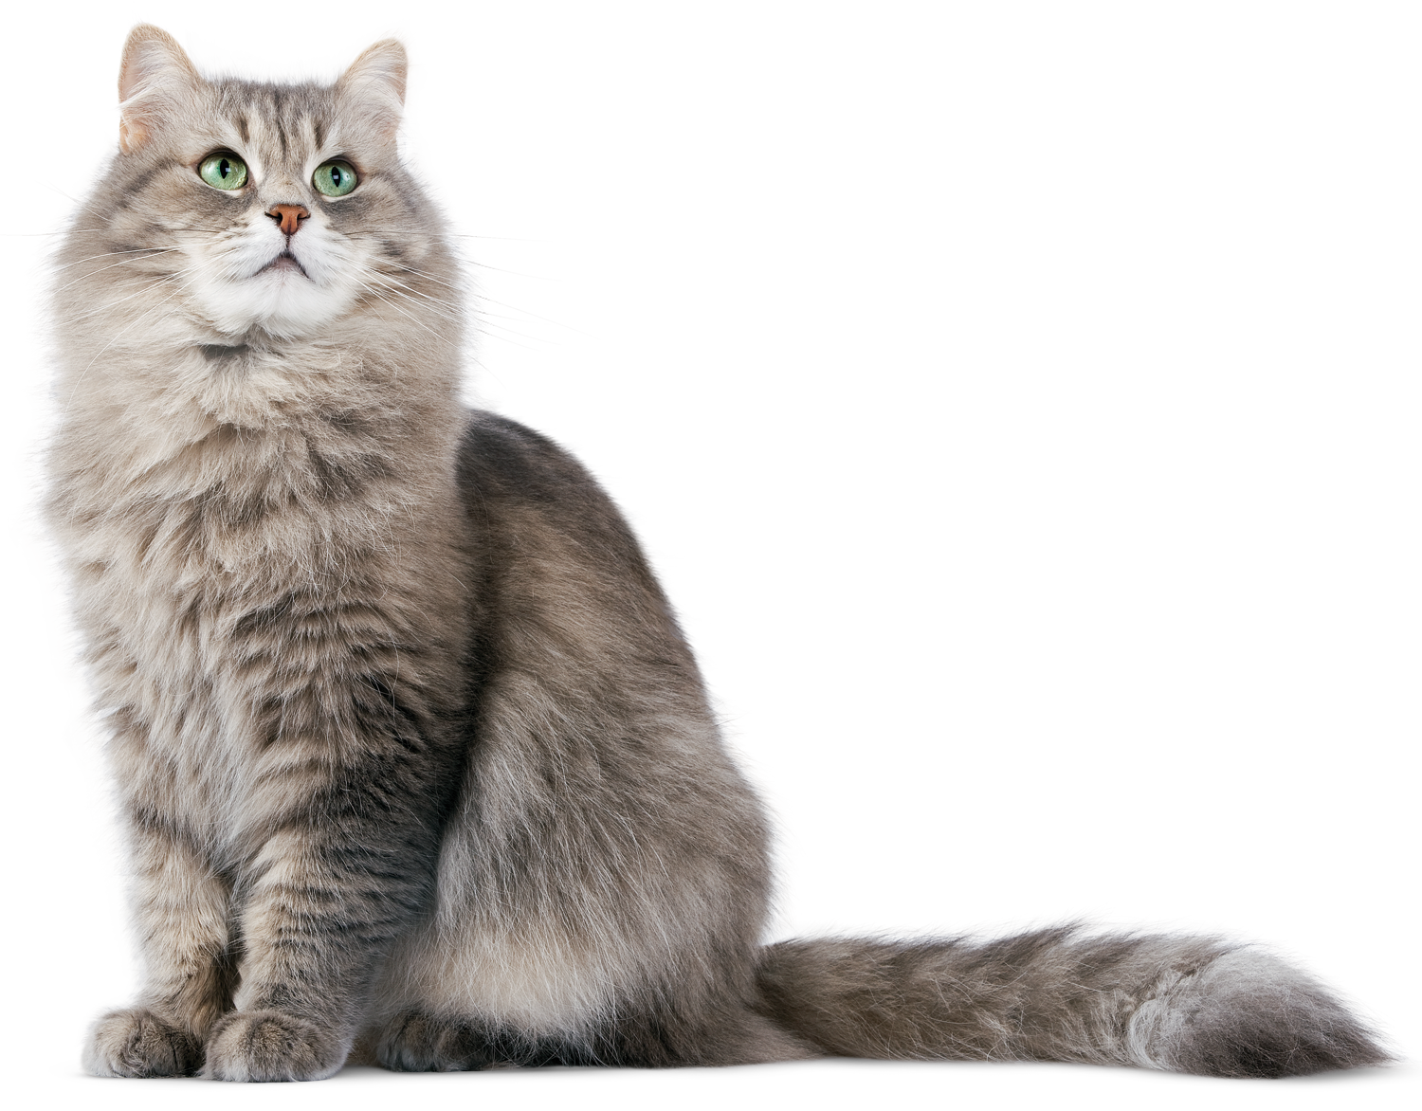

Slide 12
